Slide 1
Introduction to complexity theory

Slide 2
Why Computational Efficiency Still Matters?
Computers execute tasks extremely fast, but real-world problems can be too large to handle.
As computers advance, we attempt to solve bigger problems, keeping us limited by capacity.
Early computers were large, but had far less computational power than modern smartphones.
Despite advancements, computational and memory constraints remain. Hence, we need to analyze the efficiency of our program using “Complexity Theory”

Slide 3
Importance of Program Efficiency
Efficient programming is crucial due to limited computational resources.
In classroom settings, we almost never encounter this issue because the inputs to our problems are quite small.
As a result, even an inefficient program can process them very fast (in computer terms).
However, real-world problems involve massive inputs, making efficiency critical.
Poorly optimized programs can lead to
Unacceptable execution times
High memory consumption

Slide 4
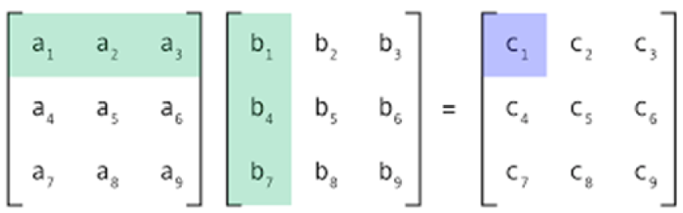
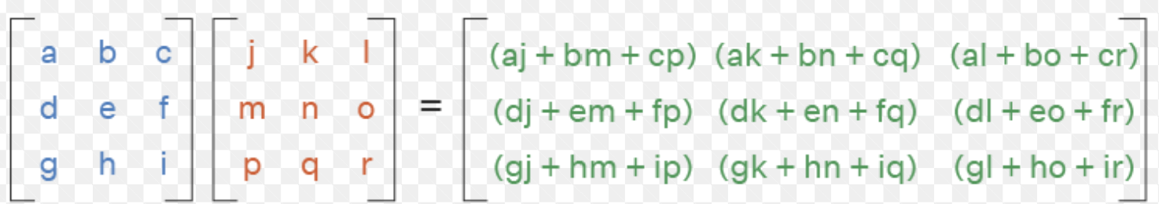
Example – Matrix Multiplication Complexity
Matrix multiplication: C = A × B, where C’s elements are computed using row-column multiplication.

Slide 5
Example – Matrix Multiplication Complexity
Matrix multiplication: C = A × B, where C’s elements are computed using row-column multiplication.
If A and B are 3 × 3 matrices:
Each C element requires 3 multiplications, C has 9 elements
Total multiplications = 3 × 9 = 27
At 2 GHz CPU speed (~1 operation per nanosecond), takes ~27 nanoseconds.
27 × 10^(-9) seconds = 27 nanoseconds.

Slide 6
Example – Matrix Multiplication Complexity
Matrix multiplication: C = A × B, where C’s elements are computed using row-column multiplication.
If A and B are 10,000 × 10,000 matrices:
Each C element requires 10,000 multiplications.
Total multiplications = 10^4×10^4×10^4=10^12
At 2 GHz CPU speed (~1 operation per nanosecond), takes ~16.67 minutes.
1012* 10^-9 seconds = 1000 seconds =16.67 minutes
Larger matrices drastically increase execution time.

Slide 7
Example – Memory Consumption Issue
Memory efficiency is crucial to avoid excessive resource usage.
For example:
Bangladesh NID database has 50 million entries (~5×10^7).
Each name: 20 characters
So, for 50M entries of names→ 100 MB total ((5 X 10^7) X 20=10^9 bytes).
If additional data is stored, memory usage can exceed 1 GB.
Problem: A simple program that loads the entire file into memory uses at least 100 MB
May exceed 1 GB if additional data is included.
Concern: Personal computers have 8-16 GB RAM
A single inefficient program can severely impact performance.

Slide 8
Understanding Time & Space Complexity
CPU time and memory space are scarce resources that must be used efficiently.
Two key measures of efficiency:
Time Complexity → How execution time grows with input size.
Space Complexity → How much memory the program consumes.
Performance varies based on input, but we focus on the worst-case scenario:
Worst-case complexity determines 1) maximum resource needs and 2) execution time limits.
While best-case and average-case complexities exist, this course focuses only on worst-case complexity.

Slide 9
Improving Worst-Case Performance of a Program
Small modifications can drastically improve performance.
Example: Searching in the NID database
Naïve approach: Load the entire file into memory
High memory usage (~1 GB).
Optimized approach: Read one line at a time, compare, then discard if not a match
Only 20~100 bytes needed.
Performance gain: Stops searching early if a match is found,
reducing execution time.
Most performance improvements require clever algorithms and data structures.
Thus, Data Structures & Algorithms (DSA) are core areas of computer science for this reason.

Slide 10
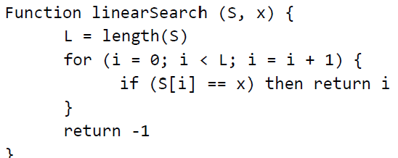
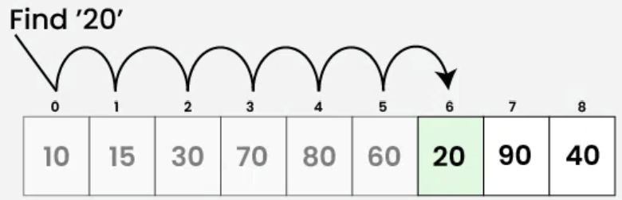
Linear Search

Slide 11
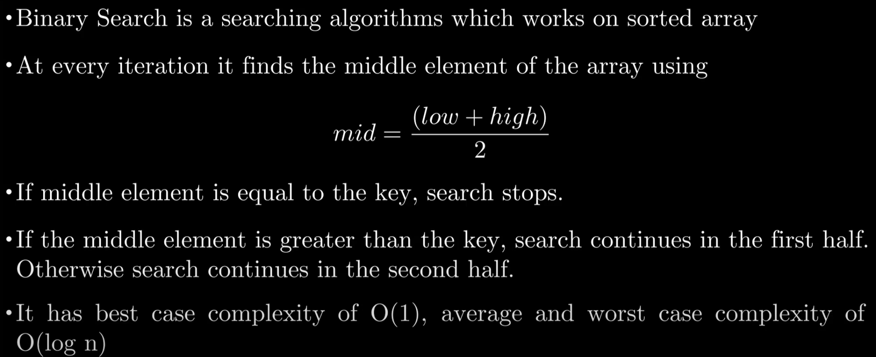
Binary Search [data sorted in ascending]

Slide 12
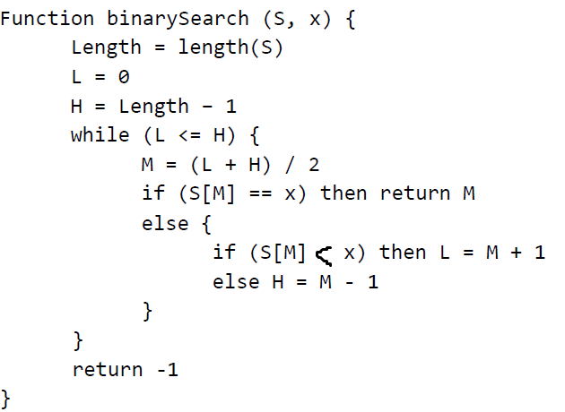
Binary Search [data sorted in ascending]

Slide 13
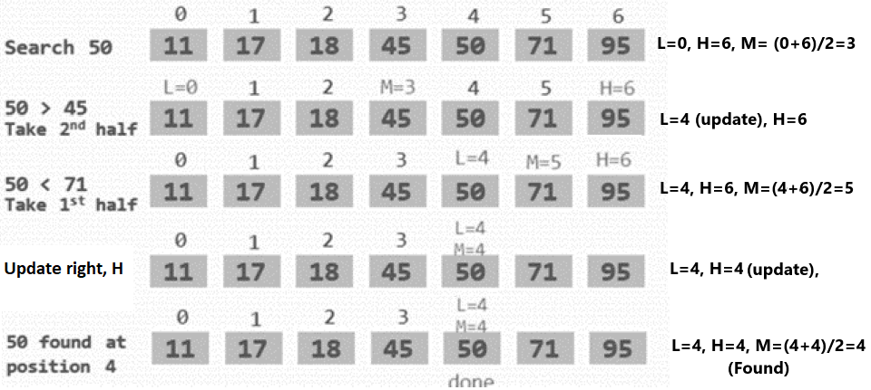

Slide 14

Binary Search video
https://www.youtube.com/watch?v=kazvOikPQrk

Slide 15
Comparing Linear Search vs. Binary Search
Linear Search: O(N)
Directly checks each element.
Example: If N=1024, it takes 1024 comparisons.
Binary Search: O(log⁡₂N)
Cuts the search space in half each step.
Example: If N=1024, it only takes 10 comparisons (log⁡₂1024 = log⁡₂2¹⁰ = 10).
Key Takeaway:
Binary search is exponentially faster than linear search for large inputs.
Choosing the right algorithm can drastically improve performance.

Slide 16
Understanding Asymptotic Complexity
Asymptotic complexity describes how a program’s resource usage grows with input size N.
Example: If complexity is O(N^2), the actual time/space usage is C⋅N^2 for some constant C.
The constant C depends on:
Code implementation details.
CPU architecture and operation costs.
Data size and structure.
We focus on how complexity scales rather than exact execution time.

Slide 17
Example – Linear Search Complexity
Operations in worst-case for input size N:
Compute length → 1 operation.
Increment loop index → N additions.
Compare index with length → N comparisons.
Load and compare elements → N+ N = 2N operations.
Return statement → 1 operation.
Total: 1+ N + N + 2N+ 1 = 4N+2 operations.
If another implementation takes 3N+2,
It’s better, but constant differences don’t matter much.

Slide 18
Why Ignore Constant Factors in Complexity?
Compilers optimize execution, making small differences negligible.
Different CPU operations have varying execution costs, making exact timing unpredictable.
Hardware improvements make constant factor differences irrelevant over time.
What matters is how complexity grows with input size rather than small efficiency differences.

Slide 19
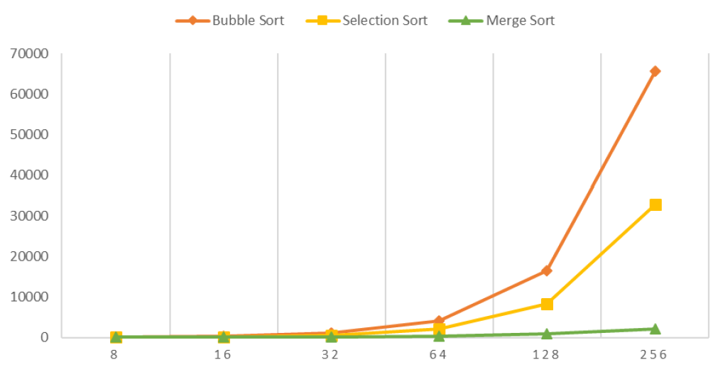
Comparing Sorting Algorithm Efficiency
Selection Sort: O(n^2), runs in (n(n+1))/2 time. [Pattern/growth trend same]
Bubble Sort: O(n^2), similar growth as selection sort. [Pattern/growth trend same]
Merge Sort: O(nlog⁡n) significantly faster for large inputs.

Slide 20
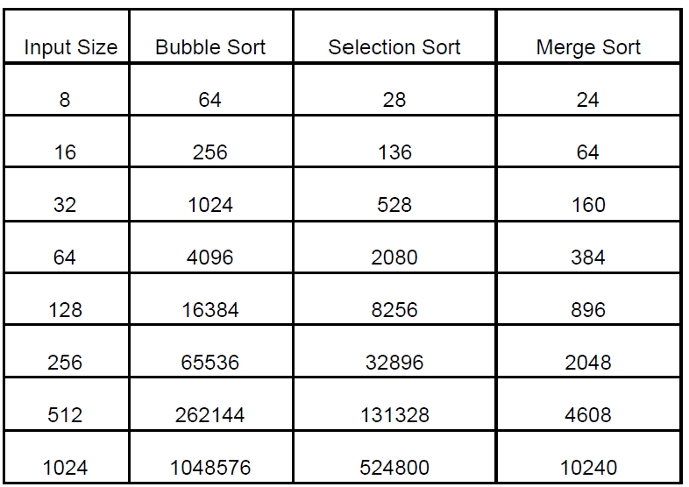
Comparing Sorting Algorithm Efficiency
Selection Sort: O(n^2), runs in (n(n+1))/2 time.
Bubble Sort: O(n^2), similar growth as selection sort.
Merge Sort: O(nlog⁡n) significantly faster for large inputs.
✅ For small inputs, all three perform similarly.
✅ As N grows, merge sort outperforms both selection and bubble sort.
✅ Constant factors are negligible; the dominant term determines efficiency.

Slide 21
Space Complexity of Bubble, Selection, and Merge Sort
Bubble Sort and Selection Sort are in-place sorting algorithms.
They only require a small, constant amount of extra memory for swaps.
Therefore, their space complexity is O(n).
Merge Sort, though also an in-place algorithm, requires extra memory for temporary subarrays during the merging process.
The space needed for the subarrays is proportional to the input size.
Thus, the space complexity of Merge Sort is also O(n).
All three sorting algorithms have O(n) space complexity
Despite the different mechanisms used in the algorithms,
The additional memory used is proportional to the input size,

Slide 22
Understanding Big-O Notation
What is Big-O Notation?
It describes the worst-case time or space complexity of an algorithm as input size N grows to infinity.
It helps compare algorithms by focusing on their growth rate, ignoring
1) Constant factors (Multiplicative & Additive)
2) Lower-order terms
Example1 (constant factors): O(N)
Linear search algorithm takes T(N) = 4N + 2 operations in the worst case.
Multiplicative constants (4) are ignored because they don’t affect growth rate.
Additive constants (+2) are insignificant for large N.
Example2 (lower-order terms):
If time complexity is an^3 + bn^2 + cn + d,
we write O(N^3) because N^3 dominates for large N.

Slide 23
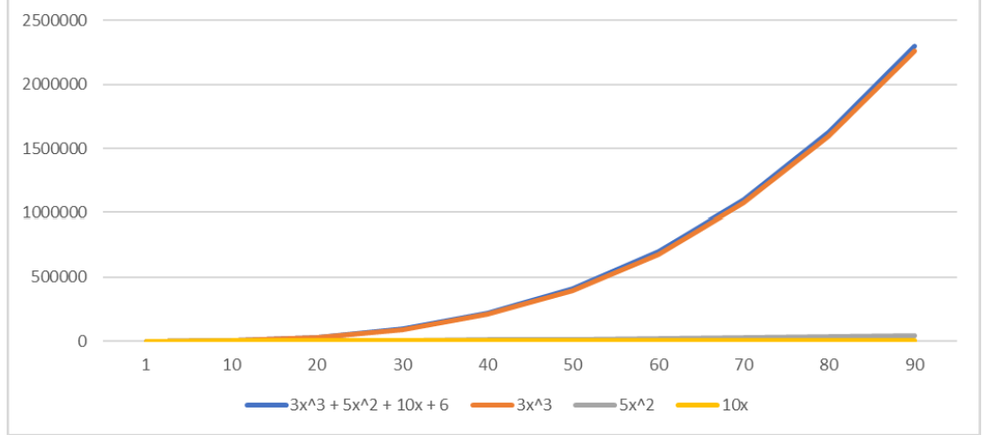
Understanding Big-O Notation
Ignores lower-order terms:
3x^3+5x^2+10x+6 and 3x^3 have same time complexity
5x^2 is 2nd lowest
10x has the lowest

Slide 24
How to Read Big-O Notation
O(1)→ "Order 1" (Constant time)
O(log⁡N)→ "Order log N" (Logarithmic time)
O(N) → "Order N" (Linear time)
O(Nlog⁡N)→ "Order N log N" (Log-linear time)
O(N^2) → "Order N squared" (Quadratic time)
O(N^3) → "Order N cubed" (Cubic time)
O(2^N)→ "Order 2 to the power of N" (Exponential time)
O(N!)→ "Order N factorial" (Factorial time)
Bubble/Selection Sort → O(N^2)(quadratic).
Merge Sort → O(Nlog⁡N) (log-linear).

Slide 25
Typical Running Time Functions
1 (constant running time):
Instructions are executed once or a few times
logN (logarithmic)
A big problem is solved by cutting the original problem in smaller sizes, by a constant fraction at each step
Shortcut: the number that is used for division or multiplication will be the base of log
N (linear)
A small amount of processing is done on each input element
N logN
A problem is solved by dividing it into smaller problems, solving them independently and combining the solution

Slide 26
Typical Running Time Functions
N² (quadratic)
Typical for algorithms that process all pairs of data items (double nested loops)
N³ (cubic)
Processing of triples of data (triple nested loops)
N^{K} (polynomial), 2^{N} (exponential)
Few exponential algorithms are appropriate for practical use

Slide 27
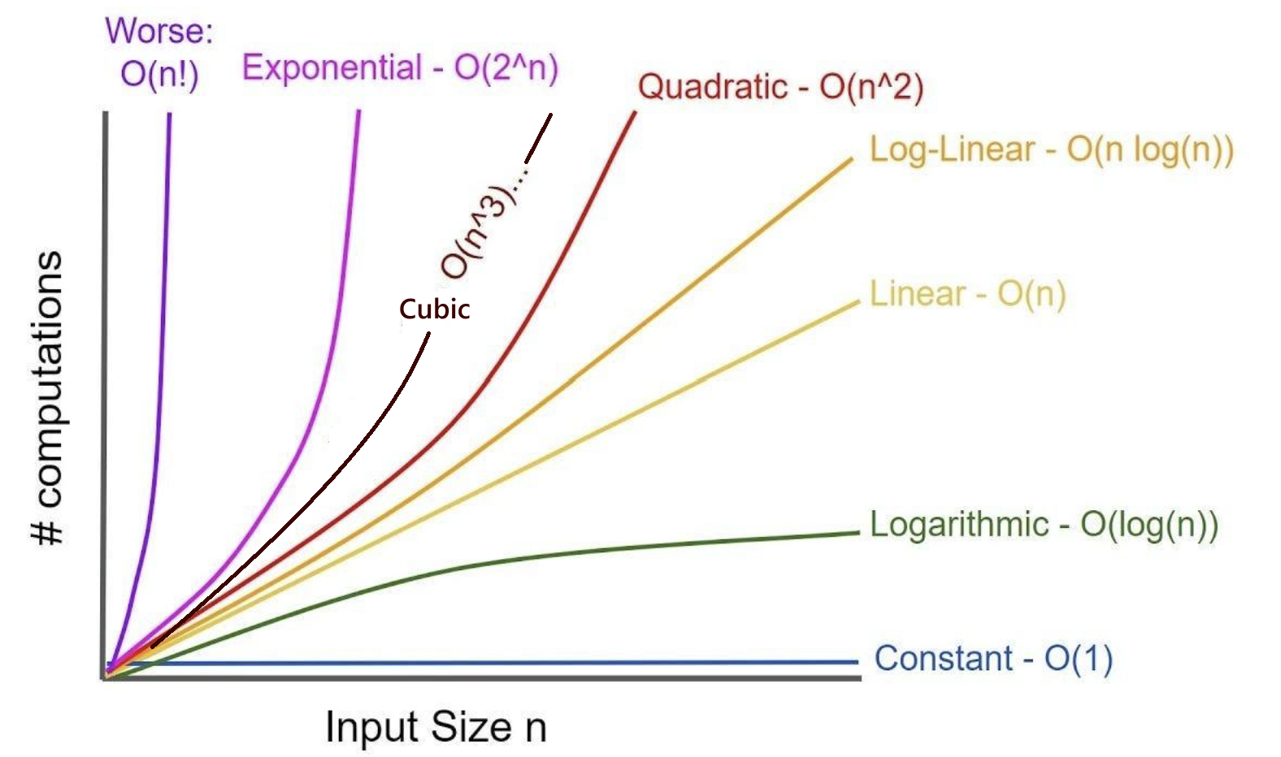
Typical Running Time Functions

Slide 28
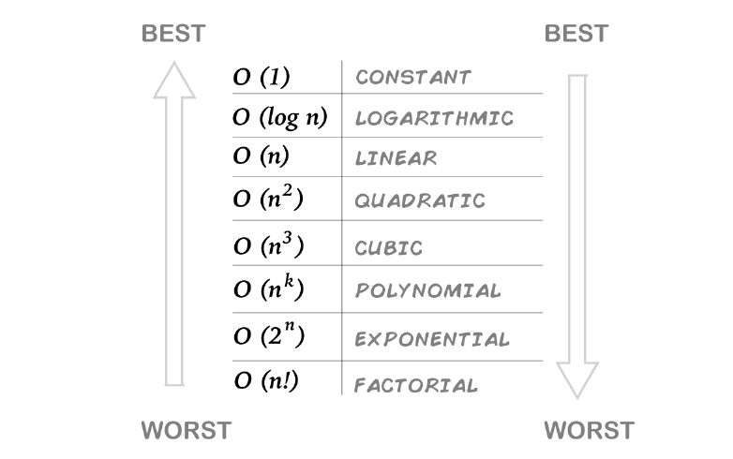
Typical Running Time Functions

Slide 29
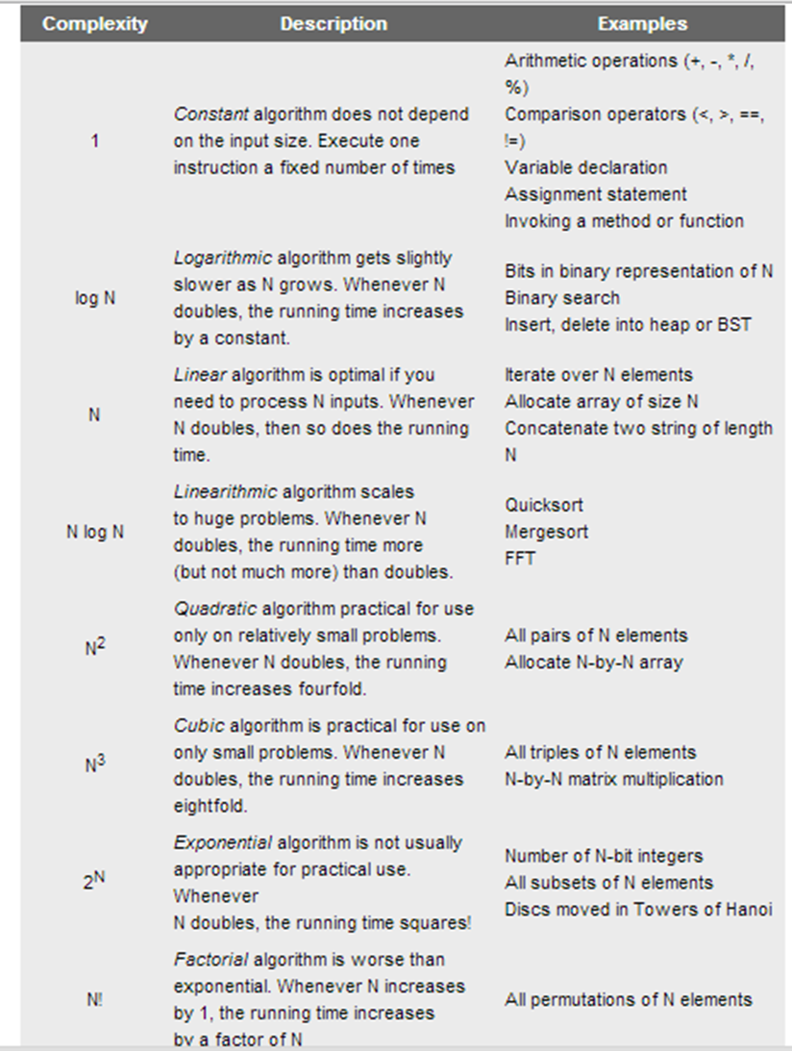

Slide 30
Example01
Code:
a = b;
Time complexity: ? Space complexity: ?

Slide 31
Example01
Code:
a = b;
Time complexity: O(1) Space complexity: O(1) — Since it's a simple value assignment

Slide 32
Rules
If nested, multiply.
If sequential (in a single line), add.
Constant factors: 2 types –Remove them
Multiplicative
Additive
Lower-order terms – Remove them
Shortcut for constant: If it can be counted on your fingers, treat it as O(1).

Slide 33
Example02
Code:
sum = 0;n=100;
for (i=1; i <=n; i++) sum += n;
Time complexity: ? Space complexity: ?

Slide 34
Example02
Code:
sum = 0; O (1)
for (i=1; i <=n; i++) // O (n) sum += n; O (1)
Time complexity: O (1) + O (n) X O (1)
= O (1) + O (n)
= O (n) Space complexity: O(1) — The loop runs O(n) times, but no extra space is used apart from a few variables, making it constant space.

Slide 35
Example03
Code:
sum1 = 0;
for (i=1; i<=n; i++)
for (j=1; j<=n; j++)
sum1++;
Time Complexity: ? Space complexity:??

Slide 36
Example03
Code:
sum1 = 0;O(1)
for (i=1; i<=n; i++) O(n)
for (j=1; j<=n; j++) O(n)
sum1++; O(1)
Time complexity: O(1) + O(n) x O(n) x O(1) = O(n²) Space complexity: O(1) — only a few integer variables are used, requiring constant space.

Slide 37
Example04
Code:
sum1 = 0;
for (i=1; i<=n; i++)
for (j=1; j<=2*n; j++)
sum1++;
Time complexity:?? Space complexity:??

Slide 38
Example04
Code:
sum1 = 0; O(1)
for (i=1; i<=n; i++) O(n)
for (j=1; j<=2*n; j++) O(2n) = O(n)
sum1++; O(1)
Time complexity: O(1) + O(2n) x O(n) = O(n²) Space complexity: O(1)

Slide 39
Example05
Code:
sum = 0; n=100;
for (j=1; j<=n; j++)
for (i=1; i<=j; i++)
Sum++;
for (k=0; k<n; k++)
s = k;
Time complexity: ? Space complexity:??

Slide 40
Example 05
Code:
sum = 0, n = 100; O(1)
for (j=1; j<=n; j++) O(n)
for (i=1; i<=j; i++) O(n), max value of j is n
Sum++; O(1)
for (k=0; k<n; k++) O(n)
s = k; O(1)
Time complexity: O(1) + O(n²) + O(n) = O(n²) Space complexity: O(1)
O(n)* O(n) * O(1) = O(n^2)
O(n)* O(1) = O(n)

Slide 41
Example06
Code:
sum1 = 0; n = 100;
for (k=1; k<=n; k*=2) // k = k*2
for (j=1; j<=n; j++)
Sum1++;
Time complexity: ?? Space complexity:??

Slide 42
Example06
Code:
sum1 = 0; O(1) n = 100; O(1)
for (k=1; k<=n; k*=2) //k starts at 1 and doubles each time
//(runs for half of n time) = O(log₂n)
for (j=1; j<=n; j++)//j runs from 1 to n = O(n)
Sum1++; O(1)
Time complexity: O(1) + O(1) + O(log₂n) x O(n) = O(nlog₂n) Space complexity: O(1)

Slide 43
Example06
Code:
sum1 = 0; n = 100;
for (k=1; k<=n; k*=2) // k= 1 2 4 8 16 32 64 = total 7 time loop runs for (j=1; j<=n; j++)
sum1++;
Time complexity: O(log₂n) x O(n) = O(nlog₂n)
log₂(100)= 6.67= approx 7

Slide 44
Example07
Code:
sum1 = 0; n = 100;
for (i=n; i>=1; i=i/2)
for (j=1; j<=n; j++)
Sum1= Sum1 + i ;
Time complexity: ? Space complexity:???

Slide 45
Example07
Code:
sum1 = 0; O(1) n = 100; O(1)
for (i=n; i>=1; i=i/2) //i starts at n and is halved each time //= O(log₂n)
for (j=1; j<=n; j++)//j runs from 1 to n = O(n)
Sum1= Sum1 + i ; O(1)
Time complexity: O(1) + O(1) + O(log₂n)x O(n) = O(nlog₂n) Space complexity: O(1)

Slide 46
Example07
Code:
sum1 = 0; n = 100;
for (i=n; i>=1; i=i/2) // i= 100 50 25 12 6 3 1 = total 7 times for (j=1; j<=n; j++) O(n) Sum1= Sum1 + i ; O(1)
Time complexity: O(log₂n)x O(n) = O(nlog₂n)
log₂(100) = 6.67 = approx 7

Slide 47
Example08
Code:
a=0 N= 5 i=N
while (i>0): a = a+ i; i = i/2
Time complexity: ?? Space complexity:??

Slide 48
Example08
Code:
a=0 N= 5 i=N
while (i>0): a = a+ i; O(1) i = i/2 //i starts at N and is halved each time = O(log₂n)
Time complexity: O(log₂n)X O(1) = O(log₂n) Space complexity: O(1)

Slide 49
Example09
Code:
sum1 = 0; n = 100;
for (i=n; i>=1; i=i/2)
for (k=1; k<=n; k*=2)
Sum1= Sum1 + i ;
Time complexity: ?? Space complexity:??

Slide 50
Example09
Code:
sum1 = 0; n = 100;
for (i=n; i>=1; i=i/2) O(log₂n)
for (k=1; k<=n; k*=2) O(log₂n)
Sum1= Sum1 + i ; O(1)
Time complexity: O(log₂n)x O(log₂n)x O(1) = O((log₂n)²) Space complexity: O(1)

Slide 51
Example10
sum1 = 0; n = 5;
for (i=0; i<=n; i=i+1)
for (k=0; k<=i*n; k=k+1)
Sum1= Sum1 + i ; for (i=0; i<=n+n; i=i+1) sum1= sum1 + i
Time complexity: ??? Space complexity:??

Slide 52
Example10
sum1 = 0; O(1) n = 5; O(1)
for (i=0; i<=n; i=i+1) O(n)
for (k=0; k<=i*n; k=k+1) O(n²), max value of i is n
Sum1= Sum1 + i ; O(1) for (i=0; i<=n+n; i=i+1) O(2n)= O(n) sum1= sum1 + i ; O(1)
Time complexity: O(1) + O(1) + O(n³) + O(n) = O(n³) Space complexity: O(1)
O(n)* O(n²) = O(n³)

Slide 53
Multi-Parameter Complexity [examples in analysis 11, 12]
When input has multiple attributes, complexity depends on all relevant factors.
Example: Traversing a graph with N vertices and M edges → O(N+M).
Some problems require expressing complexity in terms of multiple input sizes.
We will see details in the graph

Slide 54
Example11
Code:
Sum1 = 0; n = 100; m = 10;
for (i=n; i>=1; i=i-1): for (k=1; k<=m; k=k+2): Sum1= Sum1 + i + k ; for (i=1; i<=m; i=i+1):
print(i) ;
Time complexity: ?? Space complexity:???

Slide 55
Example11
Code:
sum1 = 0; n = 100; m = 10;
for (i=n; i>=1; i=i-1): O(n) for (k=1; k<=m; k=k+2): O(m/2)= O(m) // k goes from 1 to 10 in steps of 2 → 5 iterations
Sum1= Sum1 + i + k ; O(1) for (i=1; i<=m; i=i+1): O(m)
print(i) ; O(1)
Time complexity: O(n)x O(m)x O(1) + O(m)x O(1) = O(n x m) + O(m) = O(n x m) Space complexity: O(1)

Slide 56
Example12
Code:
arr=[]; This is an empty list counter=0; N=100, M=40;
for (i=1; i<=N; i=i+1):
arr.append(i) Inserting values to empty list
for (i=1; i<=M; i=i+1):
counter+=1 Time complexity: ???? Space complexity:???

Slide 57
Example12
Code:
arr=[]; O(1)
counter=0; O(1) N=100, M=40; O(2)
for (i=1; i<=N; i=i+1): O(N)
arr.append(i) O(1)
for (i=1; i<=M; i=i+1): O(M)
counter+=1 O(1) Time complexity: O(1)+ O(1)+ O(2) + O(N)xO(1)+ O(M)x O(1)
= O(4)+ O(N) + O(M) = O(N) + O(M) = O(N+M)

Slide 58
Example12
Code:
arr=[]; This is an empty list counter=0; N=100, M=100;
for (i=1; i<=N; i=i+1):
arr.append(i) Inserting values to empty list
for (i=1; i<=M; i=i+1):
counter+=1 Space complexity: ????

Slide 59
Example12
Code:
arr=[]; counter=0; N=100, M=100;
for (i=1; i<=N; i=i+1): arr.append(i) O(N), because N number of elements are being inserted. So, space requirement is N
for (i=1; i<=M; i=i+1): O(1): Space needed for local variables only
counter+=1 Space complexity: O(N)

Slide 60
Example13
Code:
int i, j, k = 0, n=100; for (i = n / 2; i <= n; i++) {
for (j = 2; j <= n; j = j * 2) {
k = k + n / 2;
}
} Time complexity: ???

Slide 61
Example13
Code:
int i, j, k = 0, n=100; O(1)
for (i = n / 2; i <= n; i++) { O(n/2)= O(n), loop runs from n/2 to n time, total runs n/2 times for (j = 2; j <= n; j = j * 2) { O(log₂n)
k = k + n / 2; O(1)
}
} Time complexity: O(1) + O(n)x O(log₂n) x O(2)= O(nlog₂n)

Slide 62
Example14
Code:
int i, j; Assume, A[] is an array and has n=10 integer elements
if (condition) { // Suppose condition is true in some cases
for (i = 0; i < n; i++) {
a[i] = i + 2;
}
}
else {
for (i = 0; i < n; i++) {
for (j = 0; j < n; j++) {
a[i] = a[j] + 1;
}
}
} Time complexity: ???

Slide 63
Example14
Code:
int i, j; // O(1) Assume, A[] is an array and has n=10 integer elements
if (condition) { // Suppose condition is true in some cases
for (i = 0; i < n; i++) { // O(n)
a[i] = i + 2; // O(1)
}
}
else {
for (i = 0; i < n; i++) { // O(n)
for (j = 0; j < n; j++) { // O(n)
a[i] = a[j] + 1; // O(1)
}
}
} Time complexity: O(n)xO(1) + O(n)xO(n)xO(1) = O(n) + O(n²) = O(n²)
If without considering the array declaration part, Space complexity: O(1) [No extra space is used apart from loop variables.] If Considering the array declaration part, Space complexity: O(n)

Slide 64
Practical Use of Asymptotic Complexity
Ignoring Constants:
Asymptotic complexity ignores constant multipliers and additive factors.
However, constant coefficients of different powers of N may matter in real-world applications.
Estimating Resource Requirements
Used to estimate the time and space costs of a program for large input sizes.
Helps in selecting the most efficient implementation.

Slide 65
Practical Use of Asymptotic Complexity
Example: Space Complexity Limitation
Two implementations have C₁ * n log₂n and C₂ * n log₂n same time complexity (Same).
Assume:
RAM size = 32GB
Understanding the Input Size:
The maximum input size is 512M = 2²⁹ entries.
Each entry is 1 byte, so storing all entries would take 2²⁹ bytes (≈ 512MB)
Computing Memory Requirement for Processing:
The time complexity given is n log₂n.
For n = 2²⁹, we compute: nlog⁡₂n= (2^29)×(30)
Here, log₂(2²⁹) = 29, so we assume an additional small factor (≈ 30) for overhead.
Approximate: 2²⁹×30 ≈ 2²⁹×2x15 ≈ 2³⁰×15
Since 2³⁰ bytes = 1GB, Memory requirement is 15GB

Slide 66
Practical Use of Asymptotic Complexity
Example: Space Complexity Limitation
Two implementations have C₁ * n log₂n and C₂ * n log₂n time complexity (Same).
Assume:
RAM size = 32GB
Max input size = 512M (≈ 2²⁹) entries of 1 byte each
n log₂n = 2²⁹ * 30 ≈ 15GB [Memory requirement]
Impact of Constants (C₁ and C₂):
If C₁ = 2, the required space is = 2×15 GB=30 GB
This fits within the available 32GB RAM
If C₂ = 3, the required space is = 3×15GB=45 GB
This exceeds the available 32GB RAM, making execution impossible First implementation is the only viable option.

Slide 67
Practical Use of Asymptotic Complexity
Time vs. Space Tradeoff
Optimization dilemma: Faster execution often requires more space, and vice versa.
Faster execution often requires more memory due to additional data storage or complex operations.
Reducing memory usage can slow down execution due to less efficient algorithms or extra resource management steps.
Real-world impact: Some problems require balancing time and space efficiency based on constraints.

Slide 68
The End

